Slide 1
AEAC SUAS 2026 ASSESSMENT PREVIEW:
URBAN FIREFIGHTING
Big City Fire Department is soliciting bids for a firefighting unmanned aerial system (UAS) in the downtown core to make further use of the city’s UAM corridor infrastructure.
Proof-of-concept will require multiple challenges:
Task 1: Fire Reconnaissance
Task 2: Fire Extinguishing

Slide 2
2026 Urban Firefighting
Task 1: Fire Reconnaissance
Recon a fire site before firefighters get there! Fly as far as possible to a given building while transporting firefighting gear.
Visually inspect the outside of the building, map targets, and stage the equipment at a safe location.
Task 2: Fire Extinguishing
Respond to calls about a house on fire! Douse indoor and outdoor targets with water.
Target locations will be unknown, and different than Task 1 locations.

Slide 3
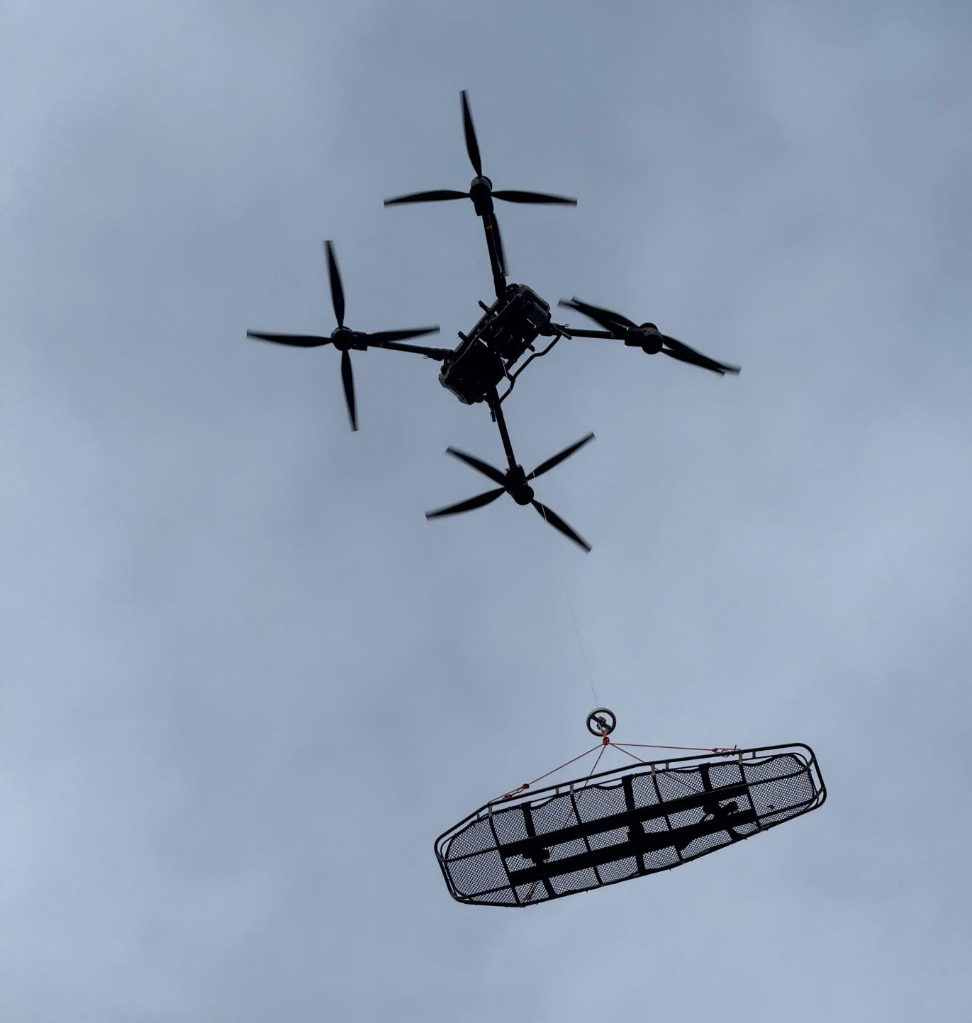
Task 1: Fire Reconnaissance
Long-Range Flying
Equipment Staging
Target Localization

Slide 4
Task 1: Fire Reconnaissance
Teams dispatch to a known location by flying as far as possible. Upon arrival, teams drop off firefighting equipment to a safe location and investigate the surrounding area to locate targets.
Goals:
Perform a long-range flight to arrive at the scene before firefighters.
Carry and safely drop off heavy firefighting equipment.
Visually detect targets and localize them in the environment.
Scoring:
Target detection location accuracy
Distance flown (simulated with laps of a given course)
Payload fraction
Safe landing at flightline

Slide 5
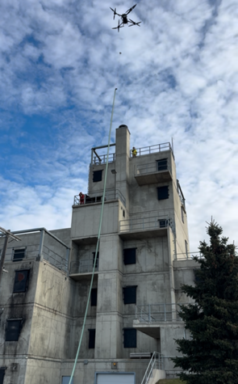
Task 2: Fire Extinguishing
Precision Water Targeting
Indoor Flight
Flight Autonomy

Slide 6
Task 2: Fire Extinguishing
Teams compete to extinguish fires inside and outside the building by hitting as many targets with water as possible.
Goals:
Spray water on targets in the area around a given GPS coordinates.
Targets may be indoors, outdoors, on the ground, elevated, inclined, or partially obscured. Indoor areas may only be partially lit.
Scoring:
Differing levels of difficulty per target hit correspond to the amount of points received for each
Points for various autonomous actions
Safe landing at flightline

Slide 7
Additional Information
Integrate with Big City’s RTM system by following their operational protocols (TBD).
Different aircraft may be used for the two tasks.
A maximum of two UAVs is permitted for Task 1. A maximum of one UAV is permitted for Task 2.
Collectively, UAVs must weigh under 15 kg including payload (firefighting equipment/water) at all times during the operation.
Batteries may be swapped at the flightline during Task 2, but not Task 1.
For Task 2, water may be loaded by hand into the UAVs during the flight window. All UAVs must be empty at the start of the flight window.

Slide 8
Important Notes
This Assessment Preview is intended to give preliminary information to help teams budget for equipment this summer.
The full CONOPS will be released in September. Details WILL change!
Please hold your questions on task details until the full CONOPS is released.
If your team has questions about what equipment will be provided, they may be directed to: katrina.cecco@aerialevolution.ca.

